Slide 1
Parking Lot Management Application
Karolina Kupiec

Slide 2
The two classes of the application
Main
The class where the application runs from
Asks the user the parking lot size, and further input during normal use.
lotManager
Sets up the parking lot based on user input.
Generates and modifies data based on user input.

Slide 3
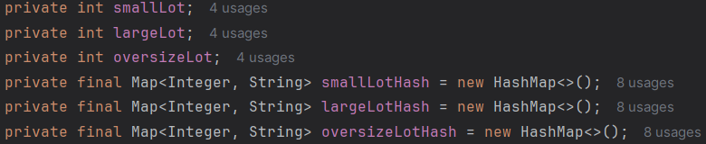
lotManager Class Variables
3 sets of integers and hashmaps, each corresponding to a specific lot type, small, large, or oversize

Slide 4
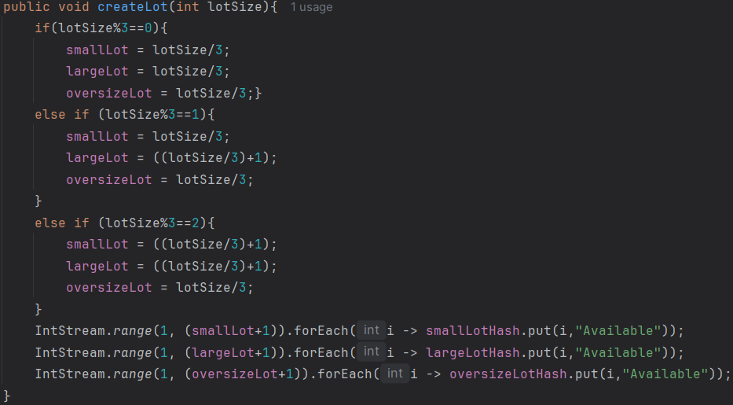
createLot method
This method takes an integer parameter and creates 3 equally divided parking lots, the remainders are prioritized to large, and then small.
The second part of this method fills each hashmap starting from 1 to lotSize+1, for each numbered key, is the value, “Available.

Slide 5
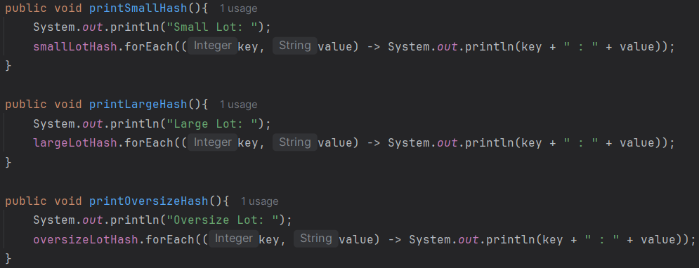
print(size)Hash
For each lot in the desired parking lot hashmap, prints the key and value, meaning lot number and availability of the lot.

Slide 6
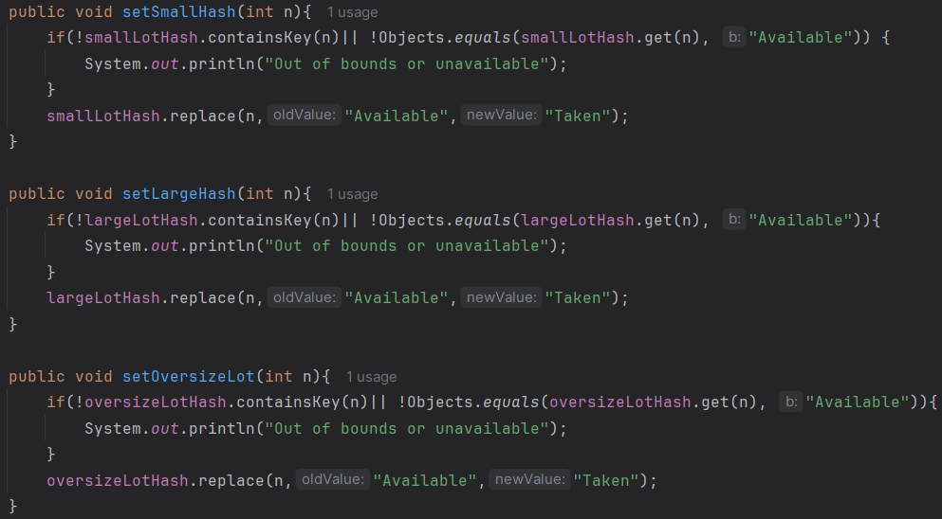
set(size)Hash
Checks if the parameter is a lot number that exists and the availability of the desired spot in the lot
If the lot number exists and if there’s space in the lot, the number is then marked as “Taken”

Slide 7
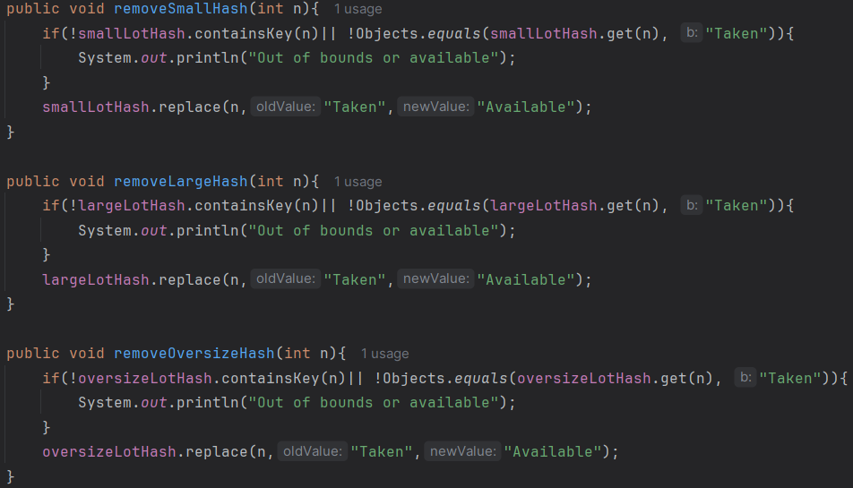
remove(size)Hash
Checks if the parameter is a lot number that exists and the availability of the desired spot in the lot
If the lot number exists and if the spot is marked as “Taken”, the value is changed to “Available”

Slide 8

Main Class Static Variables
start
Used in the initial while loop that asks the user the desired size of the parking lot
during
Used in the second while loop that continually asks the user which parking lot they want to interact with, and whether they want to add or remove a car, or check the status of the lot.
runtime
Used in the main class as the class that holds the information required by the user, such as parking lot size, and the availability of each parking lot spot. Variables in this class can be changed as required.

Slide 9
Main Method Execution
Broken up into two parts
Initial While Loop
This is where the lotManager will be set up for further use.
Second While Loop
This is where the user would be able to interact with the lotManager instance.

Slide 10
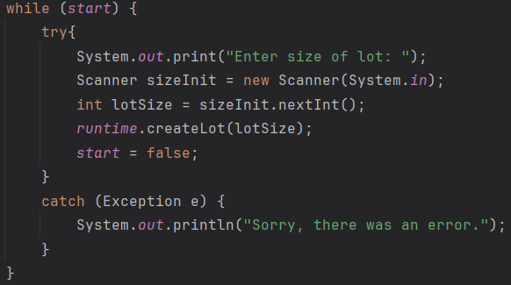
Initial While Loop
Local Variables
Scanner sizeInit
Records user input
int lotSize
Converts user input into an int to set up the parking lot
This while loop asks the user for input to create the parking lot. If it fails, it will catch the error, and prompt the user again, until it succeeds. This then ends the loop.

Slide 11
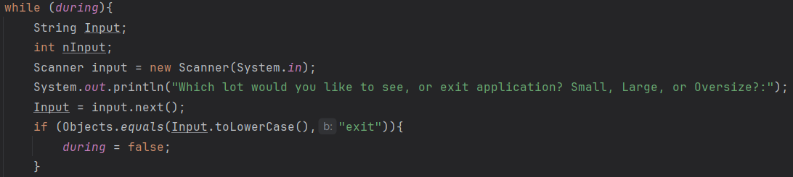
Second While Loop: Initial Question
Local Variables
String Input: String of what the user inputs
int nInput: int of what the user inputs
Scanner input: Records user input
Continual while loop, asking the user what they want to do. Here it is asking which parking lot to interact with, or “Exit” to end the while loop, and thus ending the application.

Slide 12
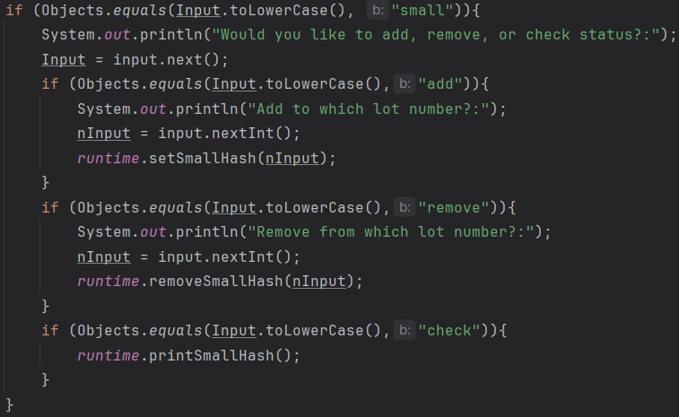
Second While Loop: Further Questions
This is the small parking lot code, but large, and oversize have similar code, but using their respectful methods.
Input is set to the user’s input, then checks which block of code to run based on input compared to the if statements
If input does not match any if statement, the user is returned to the start of the loop, asking which lot to interact with
Then, when necessary, asks the user for which lot number, for use in lotManager methods
A try block surrounds all 3 blocks of if statements, in case the user gives an input that could crash the application

Slide 13
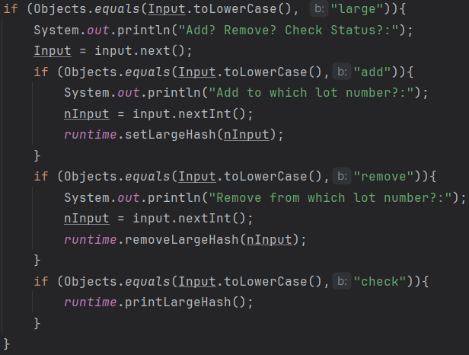
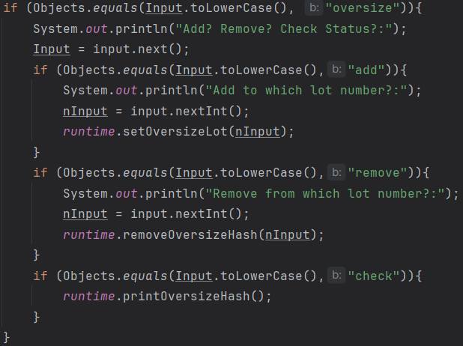
Second While Loop: Further Questions

Slide 14
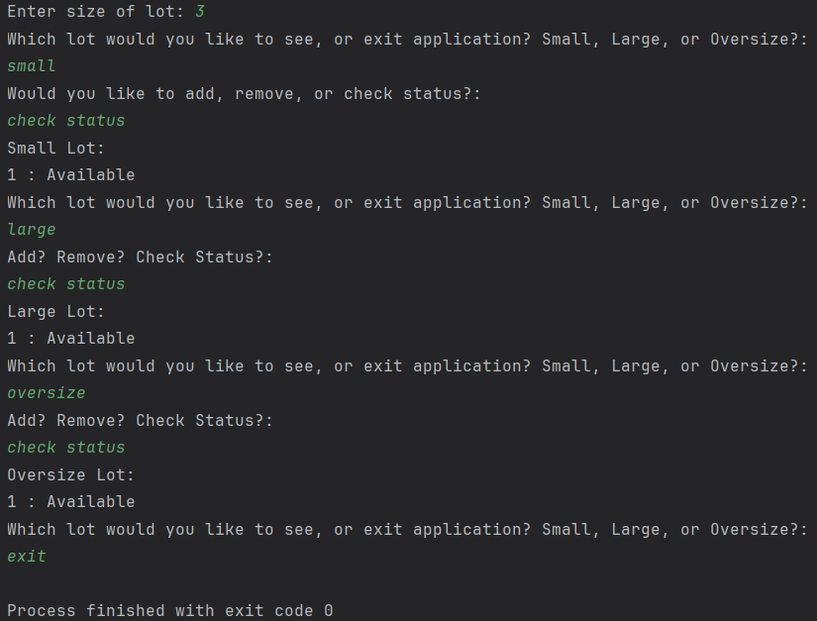
Examples
Initialization, and exiting the application. Checking the status of each parking lot section.

Slide 15
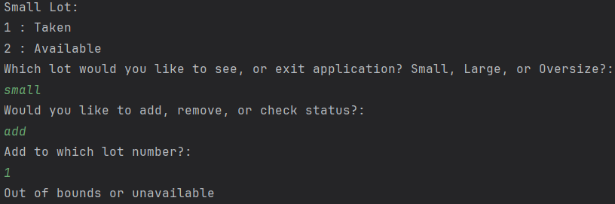
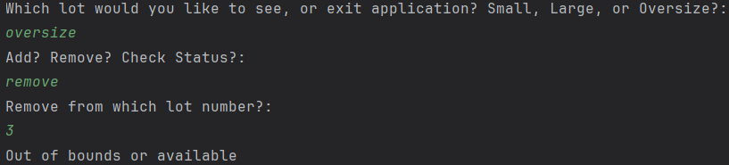
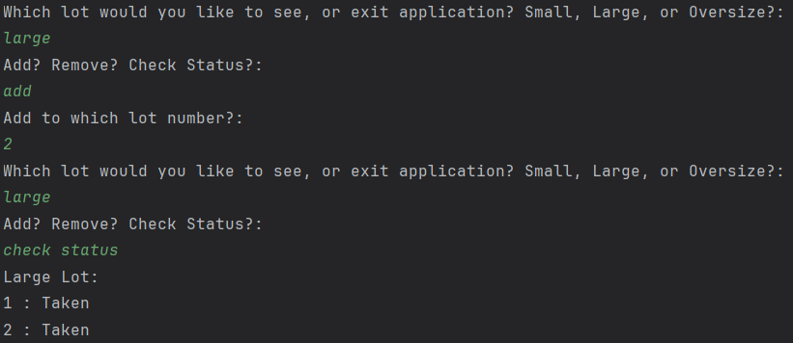
Examples
In this example: The size of the parking lot is: 6
1)User wants to add a car in small lot, number 1, but it is currently occupied.
2)User was unable to remove a car from the oversize lot because the lot number does not exist
3)User was able to add to the large lot, because the lot number exists and was available

